Slide 1
FEED MILL & GRAIN STORAGE
A MUST USE PRODUCT FOR
WELCOME TO THE WORLD OF GRAIN SCIENCE

Slide 2
For Feed Millers

Slide 3
Profits for Feed Millers
Decreases the process loss.
Using ‘Extra water’ with usage upto 30 kgs/ MT * in the feed
increases the feed weight thus increasing the overall profitability.
Because of the increase in throughput of the machine/die, the electric load / amperage will go down which decreases the electricity bill.
*The maximum usage of water with ( varies under different moisture/ climatic condition)

Slide 4
Profits for Feed Millers
Can be used in maize storage to avoid the moisture loss, shrinkage, mold and pest infestation also to retain the nutritional value because of microorganism spoilage and also maintains the freshness of the major input raw material without spoilage & degradation.
Decreases the bacterial and fungal load because of proper cooking,
gelatinization.
Minimizes the fines and zeroing down on molds.

Slide 5
Profits for Feed Millers
Increases the life of the die.
Increases the throughput of the machine thus increasing the final
output/hour and decreasing the number of hours on the labour cost.
Smooth running of plant decreases the overall maintenance cost.
Extra profits from decreased medicine usage in feed such as toxin
binders, mold inhibitors etc.,

Slide 6
Feed Quality
Controls moisture in the feed and avoids weight loss due to moisture.
Decreases the fines in the feed.
Improves the cooking of pellets and also improves the palatability.
Improves the colour of the feed.

Slide 7
Feed Quality
Improves the digestion of the bird, leads to lessor intake of water and more of feed, finally decreasing the number of days of production/batch.
Decreases the bacterial and the fungal load of the feed.
Decreases the toxicity of feed and in turn of the bird thus decreasing the mortality.
Increases the shelf life of the feed.

Slide 8
Feed Quality
Almost minimizes the weight loss in the final feed after bagging and storing at factory/ distributor or the farmer level.
Decreases the bacterial and fungal load on the bird.
Decreases the cost of medicines as the bacterial and fungal infections will go down because of proper cooking, gelatinization, fines and zeroing down on moulds.
Maintains the freshness of the feed for longer duration.

Slide 9
Customers
Improves the colour of the overall feed.
Increases the shelf life of the feed.
Almost minimizes the weight loss in the final feed after bagging and storing at factory/ distributor or the farmer level.
Increases the no. of lots / year and thus increasing the usage of feed of any particular and overall clientele.

Slide 10
Customers
Decreases the number of diseases in the bird, improves the F.C.R, the Mold issues, the Bag weight issues, the feed colour, the fines at the farm levels thus increases the loyalty of distributors, Integrator and farmers.
With better margins, productivity, product quality and increased
margins for the end users you can penetrate faster In the market
and grow your business.

Slide 11
Effect on Bird
Decreases the toxicity of feed and in tern of the bird thus decreasing the mortality.
Decreases the bacterial and fungal load on the bird.
Improves the Feed Intake.
Improves the digestibility and the G.I track.
Decreases the overall Infection in birds.

Slide 12
Dosage
Under conditions where the grains used for making the feed are having moisture under 14% ,1 kg of
solution per Metric ton to be mixed with the feed in the
mixture.
In case of moisture is above 14% in any of the grains
the dosage would be 1.25 kg of per MT

Slide 13
For Grain Storage

Slide 14
Usage
The product is totally food grade and can be mixed/ sprayed easily on any whole or broken grain meant for storage.
It can be sprayed/ mixed on grains under any storage facility viz., gunny bags or storage in silos.
The best substitute to fumigation and other storage medicines such as ‘Celphos’ (Aluminum phosphide) better known as the death pill.

Slide 15
Usage Areas
It can be used in the grain storage of any kind of grain.
Used in the Animal feed Mills to minimize the process loss and increase profits in many other areas which this multipurpose product shall provide.
The grain traders who store , can get profited by not only minimizing the moisture loss, the insects and pest losses but also the profits from rate difference during season and off season as it also increases the shelf life of the grain.

Slide 16
Profits
Decreases the Moisture and shrinkage loss.
Decreases the bacterial and fungal damages.
Minimizes the molds/ lump formation.
Drastically reduces the pest infestation and damages
from insects, rats and birds.

Slide 17
Profits
Retains the nutritional values, maintains the freshness of the grains & avoids degradation of all types.
Avoids the toxicity issues.
Improves the food/ feed quality made from these grains.
Increases the shelf life of the grains.

Slide 18
Dosage
Under ideal conditions where there is No loss to the grain and the moisture is reasonable : 1 kg of
solution per Metric ton to be sprayed/ mixed
on/with grains.
In case of any noticeable quality issue and slight
increase in moisture : 1.25 kg per MT

Slide 19
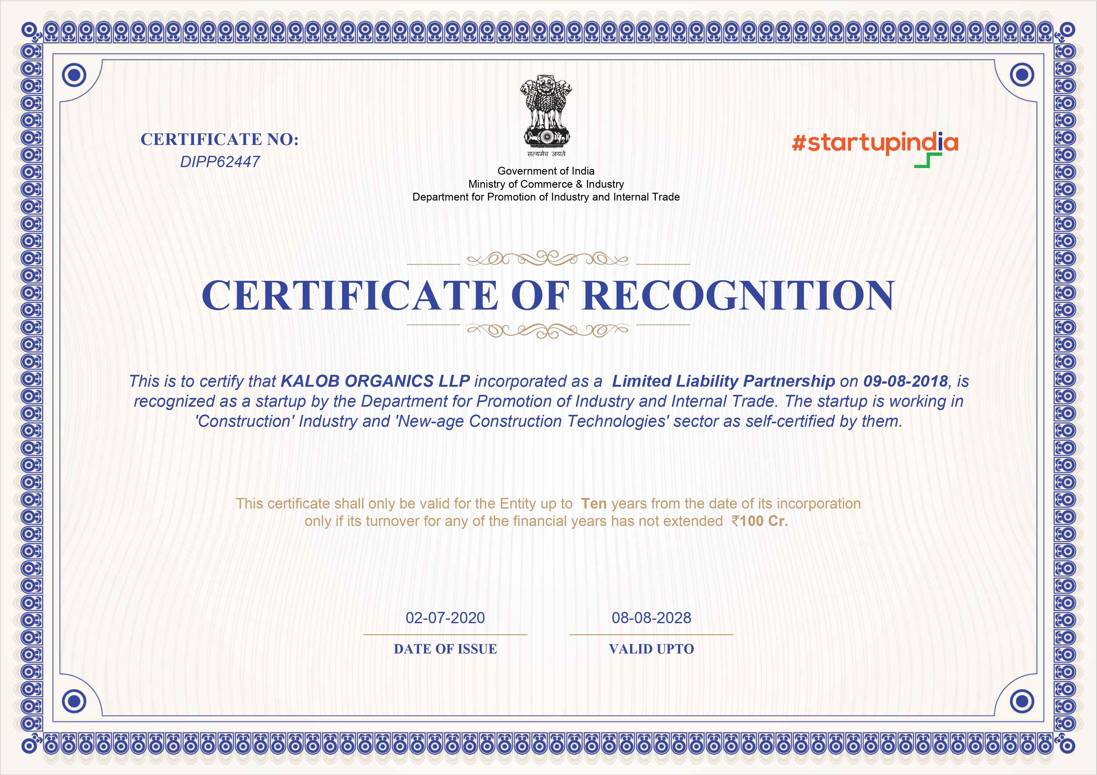

Slide 20
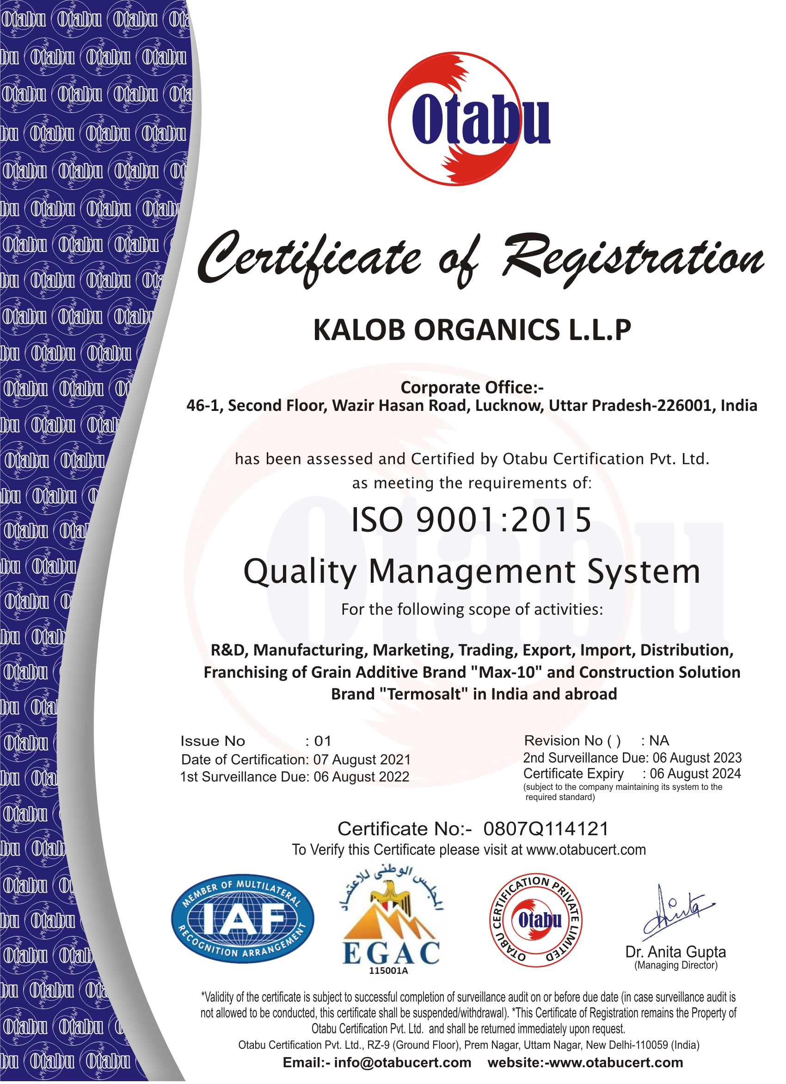
ISO

Slide 21
GMP

Slide 22
Thank you for your valuable time.
Please Feel Free to contact us
Manufactured & Marketed by
KALOB ORGANICS L.L.P
Sales Head Office: 46/1, First Floor, Wazir Hasan Road, Lucknow 226001 U.P (INDIA)
Corporate Office : 2 nd Floor, Mayfield Gardens, Sector 51, Gurugram 122001 Haryana (INDIA)
Middle East Office: Wali Al-Ahd Avenue, Maharraq 0205, Maharraq Governerate, Kingdom of Bahrain
Website : www.max-10.co.in www.max10.in
Email: support@max-10.co.in

